Slide 1

Audience Characteristics Driving Advertising Revenue
Capstone II Liudmila Khalitova
Mentor Varun Bhatia

Slide 2

Problem Statement
Organizational Background
Bulletin Healthcare produces eNewsLetters for various medical professionals which are distributed to specialized medical associations.
The NewsLetters are free for recipients, and their production costs are covered by money from advertisers who would like to target and reach physicians.
Bulletin Healthcare is looking to expand its network of healthcare professionals and increase the reach of their briefings but is unsure what kind of physicians they should focus on first.

Slide 3
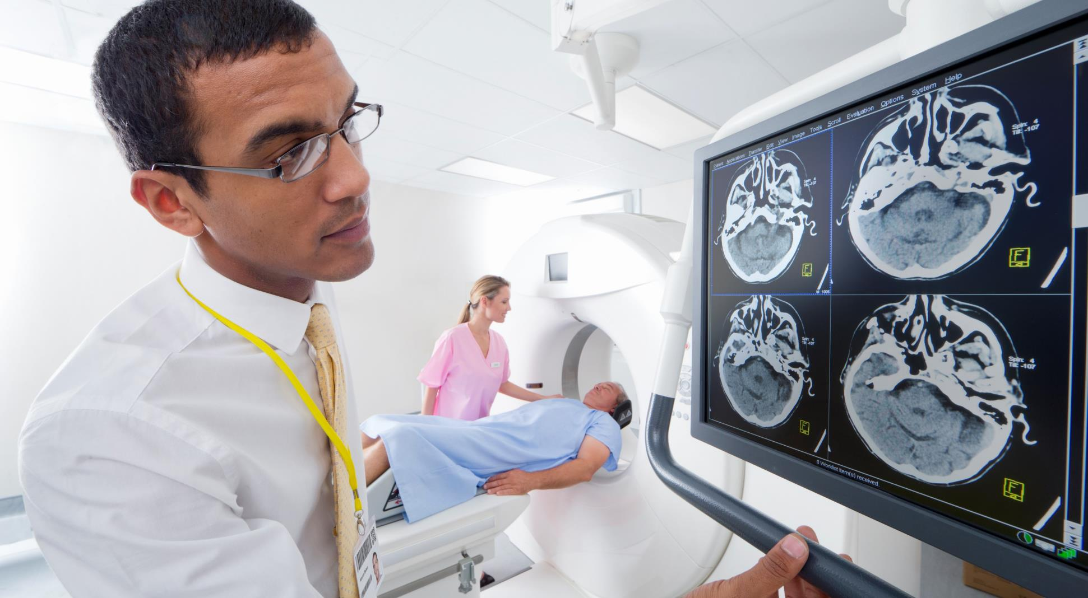



HCP Characteristics used in ad targeting
Professional Characteristics
Prescription behavior
workplace
location
Therapeutic Area
Membership in Professional Associations
Specific drugs prescribed in the past
Prescription frequency/Prescription volume
Hospital Size
Hospital Type
State, city
Zip code
GOAL OF THE PROJECT: Identify the most relevant recipient characteristics associated with advertising revenue.

Slide 4
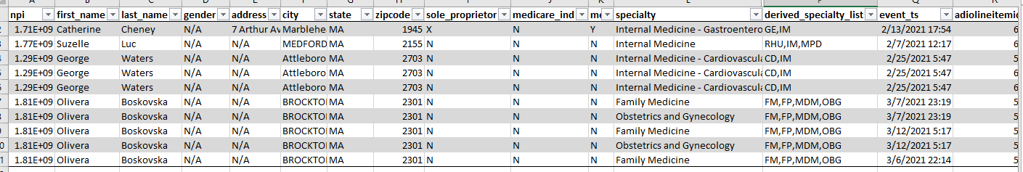
APPROACH
COMPARE THE IMPORTANCE OF HCP CHARACTERISTICS USING MULTIPLE REGRESSON
Dep. Variable: money_generated_log
R-squared: 0.380 Model: OLS Adj.
R-squared: 0.374
Method: Least Squares
F-statistic: 68.17
Prob (F-statistic): 0.00
37%
Variance Explained By The Final Model

Slide 5
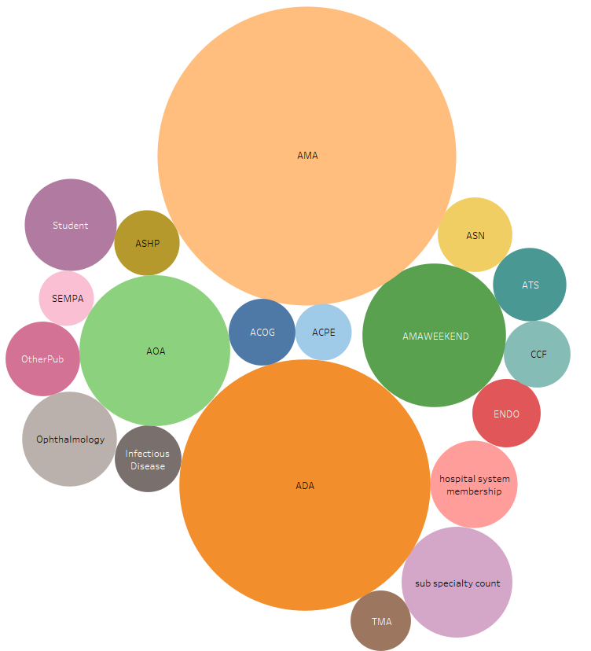
Results
The most important predictors of revenue are shown on the right. Size indicates the importance of predictors relative to one another, regardless of whether the association with revenue was positive or negative.

Slide 6
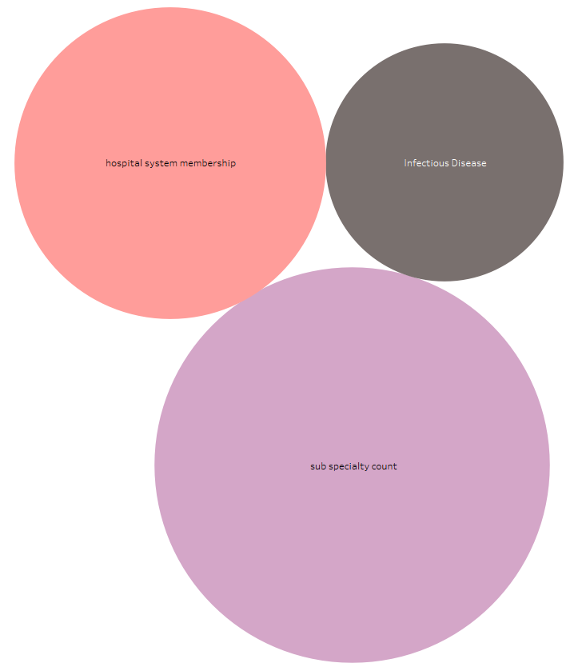
Results
Among the features that are positively associated with revenue, the number of subspecialties a recipient has plays the most important role.
This gives an advantage to doctors with narrow specializations because their broader specialties are also included into the count, in addition to subspecialties.
Doctors from large hospital systems tend to drive more revenue, compared to local hospitals. Doctors specializing in Infectious Disease also drove more revenue than doctors with other specializations. However, this migh be the effect of 2020 and COVID-19

Slide 7
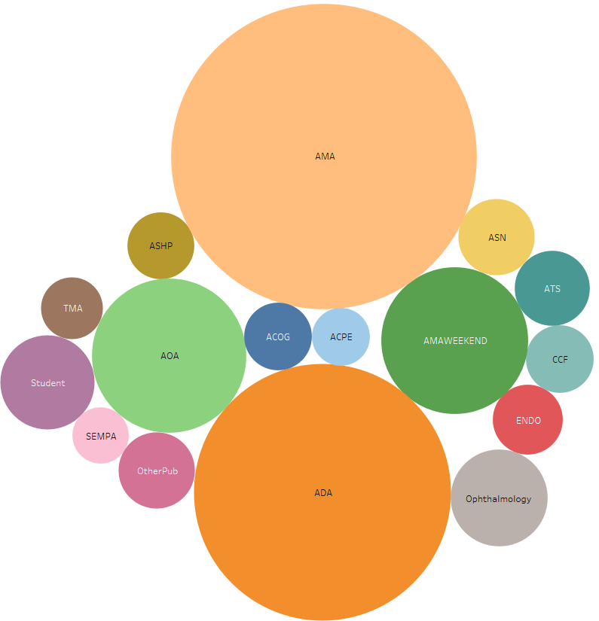
Results
The most important negative predictors of revenue were membership in the American Medical Association (AMA) whose briefings are priced lower than more specialized publications, as well as memberships in AOA (American Optometric Association) and ADA (American Dental Association), perhaps due to a fewer advertisers or products worth advertising to these audience (e.g. medications).

Slide 8

TAKEAWAYS
Bulletin Healthcare should focus on expanding its partnerships with large hospital systems such as Cleveland Clinic, Mayo Clinic, John Hopkins, etc instead of focusing on medical associations.
Recipients who specialize in therapeutic areas involving multiple specializations are the most promising targets for advertising.
In the midst of the pandemic, it might make sense expanding its reach to HCPs specializing in infectious disease.

